Slide 1


Noida Institute of Engineering and Technology Greater Noida
Operating Systems
ACSE0403A
Unit: 1
Fundamental Concepts of Operating System
Sanchi Kaushik
Assistant Professor
AIML
B Tech 4th Sem

Slide 2
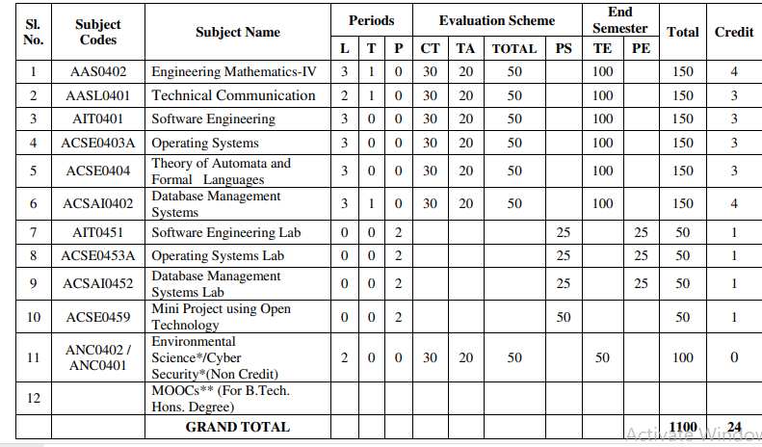
Evaluation Scheme

Slide 3
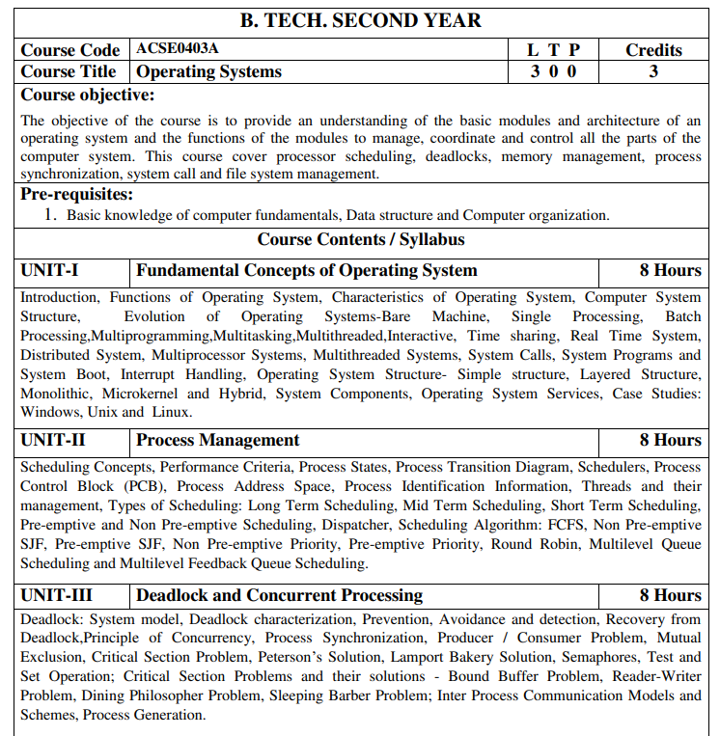
Subject Syllabus

Slide 4
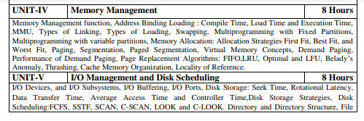

Subject Syllabus

Slide 5
Syllabus For Unit-1
UNIT-I Fundamental Concepts of Operating System
Introduction, Functions of Operating System, Characteristics of Operating System, Computer System Structure, Evolution of Operating Systems-Bare Machine, Single Processing, Batch Processing,Multiprogramming,Multitasking,Multithreaded,Interactive, Time sharing, Real Time System, Distributed System, Multiprocessor Systems, Multithreaded Systems, System Calls, System Programs and System Boot, Interrupt Handling, Operating System Structure- Simple structure, Layered Structure, Monolithic, Microkernel and Hybrid, System Components, Operating System Services, Case Studies: Windows, Unix and Linux.

Slide 6
Branch wise Applications
Airlines reservation system.
Air traffic control system.
Systems that provide immediate updating.
Used in any system that provides up to date and minute information on stock prices.
Defense application systems like RADAR.
Networked Multimedia Systems.
Command Control Systems.

Slide 7
Course Objectives
Provide an understanding of the basic modules and architecture of an operating system and the functions of the modules to manage, coordinate and control all the parts of the computer system.
Processor scheduling, deadlocks, memory management, process synchronization, system call and file system management.

Slide 8
Course Outcomes
Course outcome: After completion of this course students will be able to:
CO 1 | Understand the fundamentals of an operating systems, functions and their structure and functions. | K1, K2
CO2 | Implement concept of process management policies, CPU Scheduling and thread management. | K5
CO3 | Understand and implement the requirement of process synchronization and apply deadlock handling algorithms. | K2,K5
CO4 | Evaluate the memory management and its allocation policies. | K5
CO5 | Understand and analyze the I/O management and File systems | K2, K4

Slide 9
Program Outcomes
1. Engineering knowledge
2. Problem analysis
3. Design/development of solutions
4.Conduct investigations of complex problems
5. Modern tool usage
6. The engineer and society
7. Environment and sustainability
8. Ethics
9. Individual and team work
10. Communication
11. Project management and finance
12. Life-long learning

Slide 10
COs and POs Mapping
OPERATING SYSTEM (ACSE0403A )
CODE | PO1 | PO2 | PO3 | PO4 | PO5 | PO6 | PO7 | PO8 | PO9 | PO10 | PO11 | PO12
ACSE0403A .1 | 3 | 3 | 2 | 2 | 1 | 2 | - | 2 | 3 | 2 | 2 | 3
ACSE0403A .2 | 3 | 3 | 3 | 2 | 2 | 3 | - | 2 | 3 | 1 | 1 | 3
ACSE0403A .3 | 3 | 3 | 2 | 2 | 2 | 2 | - | 2 | 2 | 3 | 1 | 3
ACSE0403A .4 | 3 | 2 | 2 | 3 | 1 | 2 | - | 1 | 2 | 1 | 2 | 3
ACSE0403A .5 | 3 | 1 | 2 | 2 | 2 | 2 | - | 1 | 2 | 2 | 2 | 3
Average | 3 | 2.4 | 2.2 | 2.2 | 1.6 | 2.2 | - | 1.8 | 2.2 | 1.8 | 1.6 | 3

Slide 11
Program Educational Objectives (PEOs)
PEO1:Apply sound knowledge in the field of information technology to fulfill the needs of IT industry.
PEO2:Design innovative and interdisciplinary systems through latest digital technologies.
PEO3:Inculcate professional – social ethics, team work and leadership for serving the society.
PEO4:Inculcate lifelong learning in the field of computing for successful career in organizations and R&D sectors.

Slide 12
Faculty wise Result Analysis
Semester & Section | Subject Code | Result

Slide 13
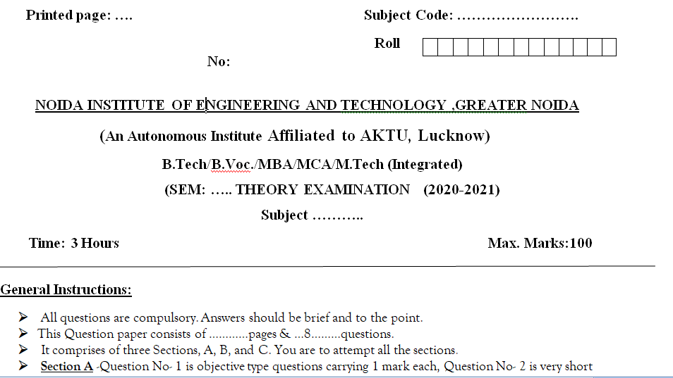
End Semester Question Paper Templates (Offline Pattern/Online Pattern

Slide 14
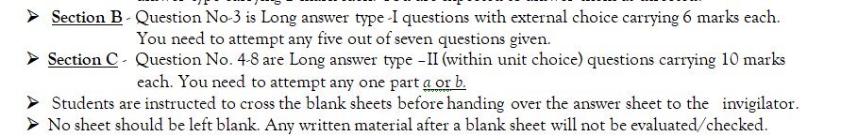
End Semester Question Paper Templates (Offline Pattern/Online Pattern

Slide 15
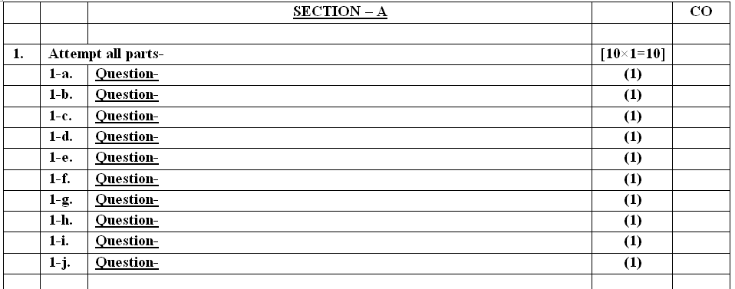
End Semester Question Paper Templates (Offline Pattern/Online Pattern

Slide 16
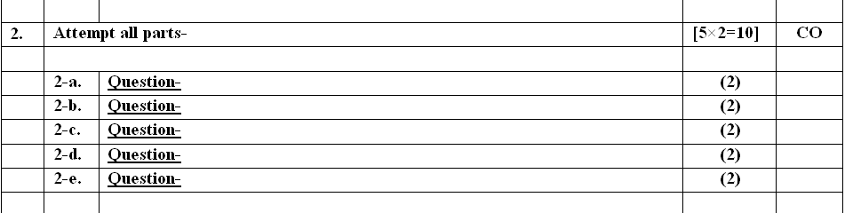
End Semester Question Paper Templates (Offline Pattern/Online Pattern

Slide 17
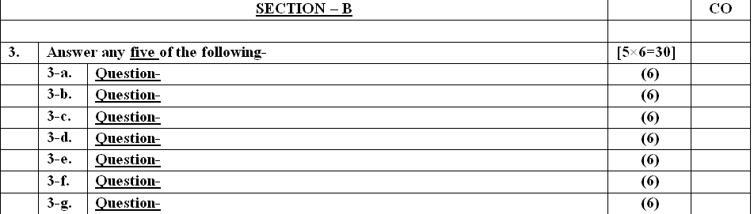
End Semester Question Paper Templates (Offline Pattern/Online Pattern

Slide 18
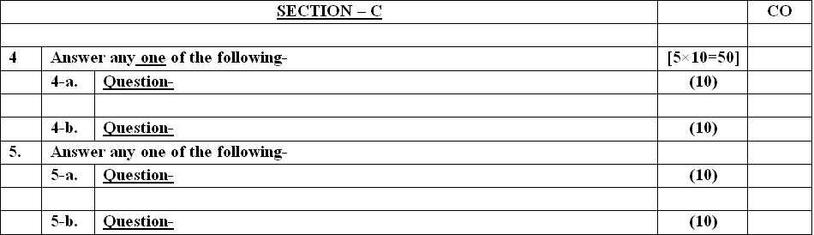
End Semester Question Paper Templates (Offline Pattern/Online Pattern

Slide 19
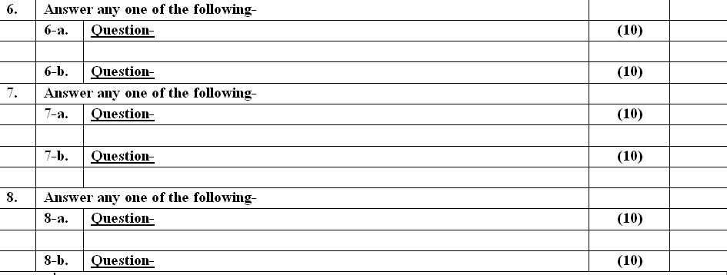
End Semester Question Paper Templates (Offline Pattern/Online Pattern

Slide 20
Brief Introduction about the subject with video
An operating system acts as an intermediary between the user of a computer and computer hardware. The purpose of an operating system is to provide an environment in which a user can execute programs conveniently and efficiently
YouTube/other Video Links
https://www.youtube.com/playlist?list=PLmXKhU9FNesSFvj6gASuWmQd23Ul5omtD

Slide 21
Prerequisite and Recap
Prerequisite:-
Basic knowledge of computer fundamentals.
Basic knowledge of computer organization.
Recap-
To cleared the knowledge about computer hardware components.
To Know the basic knowledge of software.
Student have knowledge about basic electronics.

Slide 22
Objective of unit 1
To describe the basic organization of computer systems
To provide a grand tour of the major components of operating systems
To give an overview of the many types of computing environments
To explore several open-source operating systems
To describe the services an operating system provides to users, processes, and other systems
To discuss the various ways of structuring an operating system

Slide 23
Unit - RECAP
To cleared the knowledge about computer hardware components.
To Know the basic knowledge of software.
Student have knowledge about basic electronics.

Slide 24
Topic mapping with CO
Topic | CO
Introduction to Operating System | CO1
Types of operating System | CO1
Interrupt Handling | CO1
Operating System Structure | CO1
Operating System Services | CO1

Slide 25
Topic Objectives
Topic | Objective
 | Students will be able to
Introduction of Operating System | Understand the basics of Operating System, its features characteristics and functions
Types of operating System | Understand the different types of operating System
Interrupt Handling | Understand the operating system concepts
Operating System Structure | Understand the components and internal structure of operating system
Operating System Services | Know the different types of operating system services

Slide 26
Unit-1 Content
Introduction
Functions of Operating System
Characteristics of Operating System
Computer System Structure,
Evolution of Operating Systems-Bare Machine,
Types of Operating Systems
Simple Batch Systems
Multiprogramming Batched Systems
Time-Sharing Systems
Real -Time Systems
Parallel Systems
Distributed Systems

Slide 27
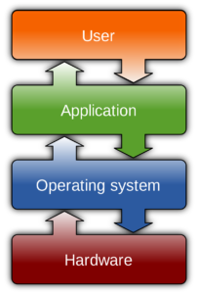
Introduction of Operating System
A program that acts as an intermediary between a user of a computer and the computer hardware.
An operating system is a program that controls the execution of application programs and acts as an interface between the user of a computer and the computer hardware.
Operating system goals:
Execute user programs and make solving user problems easier.
Make the computer system convenient to use.
Use the computer hardware in an efficient manner.

Slide 28
Objectives of Operating System
Convenience – An operating system improves the use of a machine. Operating systems enable users to get started on the things they wish to complete quickly without having to cope with the stress of first configuring the system.
Efficiency – An operating system enables the efficient use of resources.
Ability to evolve – An operating system should be designed in such a way that it allows for the effective development, testing, and introduction of new features without interfering with service.
Management of system resources – It guarantees that resources are shared fairly among various processes and users.

Slide 29
Functions of Operating System
Memory Management
Process Management
Device Management
File Management
Storage Management
Security
Job Accounting
Control over system performance
Error detecting

Slide 30
Functions of Operating System
Memory Management:- It is the management of the main or primary memory. Whatever program is executed, it has to be present in the main memory. Main memory is a quick storage area that may be accessed directly by the CPU. When the program is completed, the memory region is released and can be used by other programs. The operating system:-
Allocates and deallocates the memory.
Keeps a record of which part of primary memory is used by whom and how much.
Distributes the memory while multiprocessing.
In multiprogramming, the operating system selects which processes acquire memory when and how much memory they get.

Slide 31
Functions of Operating System
Process Management/Scheduling:-Every software that runs on a computer, whether in the background or in the frontend, is a process. The operating system determines the status of the processor and processes, selects a job and its processor, allocates the processor to the process, and de-allocates the processor after the process is completed. When more than one process runs on the system the OS decides how and when a process will use the CPU. The Operating System:-
Allocates and deallocates processor to the processes.
Keeps record of CPU status.

Slide 32
Functions of Operating System
Storage Management:-Storage management is a procedure that allows users to maximize the utilization of storage devices while also protecting data integrity . The operating system is in charge of storing and accessing files. The OS uses storage management for:
Improving the performance of the data storage resources.
It optimizes the use of various storage devices.
Assists businesses in storing more data on existing hardware, speeding up the data retrieval process, preventing data loss, meeting data retention regulations, and lowering IT costs.

Slide 33
Functions of Operating System
File Management:- The operating system manages all the records of file . It specifies which process receives the file and for how long. It also keeps track of information, location, uses, status, and so on. The files on a system are stored in different directories. The Operating System:-
Keeps records of the status and locations of files.
Creating and deleting files.
Mapping files into secondary storage .
Creating and deleting directories to organize files.

Slide 34
Functions of Operating System
Device Management:- An operating system regulates device connection using drivers. The processes may require devices for their use. This management is done by the OS. The Operating System:-
Allocates and deallocates devices to different processes.
Keeps records of the devices.
Decides which process can use which device for how much time.

Slide 35
Functions of Operating System
Security – For security, modern operating systems employ a firewall. A firewall is a type of security system that monitors all computer activity and blocks it if it detects a threat.
Job Accounting – As the operating system keeps track of all the functions of a computer system. It has an account of all the information about the memory, resources, errors, etc. Therefore, this information can be used as and when required.

Slide 36
Functions of Operating System
Control over system performance – The operating system will collect consumption statistics for various resources and monitor performance indicators such as reaction time, which is the time between requesting a service and receiving a response from the system.
Error detecting – While a computer system is running, a variety of errors might occur. Error detection guarantees that data is delivered reliably across susceptible networks. The operating system continuously monitors the system to locate or recognize problems and protects the system from them.

Slide 37
Computer System Components(CO1)
1. Hardware – provides basic computing resources (CPU, memory, I/O devices).
2. Operating system – controls and coordinates the use of the hardware among the various application programs for the various users.
3. Applications programs – define the ways in which the system resources are used to solve the computing problems of the users (compilers, database systems, video games, business programs).
4. Users .

Slide 38
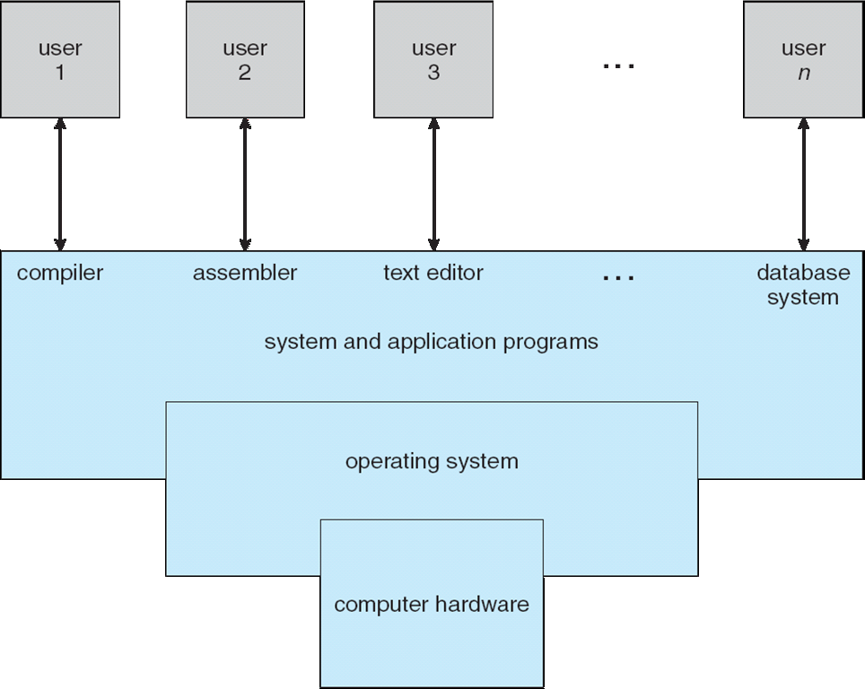
Abstract View of System Components(CO1)

Slide 39
Evolution of Operating System(CO1)
Bare Machine:
Bare machine is logical hardware which is used to execute the program in the processor without using the operating system. Initially, when the operating systems are not developed, the execution of an instruction is done by directly on hardware without using any interfering hardware.
Drawback:-
Bare machines accepting the instruction in only machine language, due to this those person who has sufficient knowledge about Computer field are able to operate a computer. so after the development of the operating system Bare machine is referred to as inefficient.

Slide 40
Evolution of Operating System(CO1)
1. Batch Operating System:-
Firstly, user prepares his job using punch cards.
Then, he submits the job to the computer operator.
Operator collects the jobs from different users and sort the jobs into batches with similar needs.
Then, operator submits the batches to the processor one by one.
All the jobs of one batch are executed together.

Slide 41
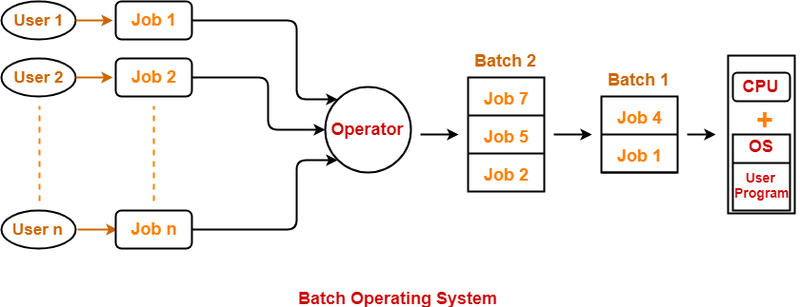
Evolution of Operating System(CO1)

Slide 42
Evolution of Operating System(CO1)
Batch Operating System Advantages:-
It saves the time that was being wasted earlier for each individual process in context switching from one environment to another environment.
No manual intervention is needed.
No special hardware required
Disadvantages:-
Priority can not be set for the jobs.
Batch operating system may lead to starvation.
CPU may remain idle for a long time.
There is a lack of interaction between a user and his job.

Slide 43
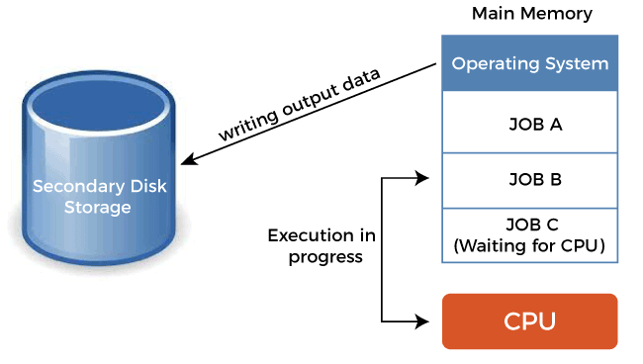
Evolution of Operating System(CO1)
2. Multiprogramming Operating System:- is an ability of an operating system that executes more than one program using a single processor machine.
More than one task or program or jobs are present inside the main memory at one point of time

Slide 44
Evolution of Operating System(CO1)
Advantages:-
CPU utilization is high because the CPU is never goes to idle state.
Memory utilization is efficient.
CPU throughput is high and also supports multiple interactive user terminals.
Disadvantages:-
CPU scheduling is compulsory because lots of jobs are ready to run on CPU simultaneously.
User is not able to interact with jobs when it is executing.
Programmers also cannot modify a program that is being executed.

Slide 45
Types of Operating Systems(CO1)
3. Time-Shared/Multitasking Operating System:- CPU performs multitasking by switching multiple jobs and executing them simultaneously. The process of switching between the jobs is performed in a very frequent and quick manner.
Some activities that the operating system performs related to multitasking are:
When the user gives any instruction to the operating system, directly it receives a very quick and immediate response.
Multitasking operating systems also known as time-sharing systems were initially developed at a very reasonable price to provide interactive use of the system.

Slide 46
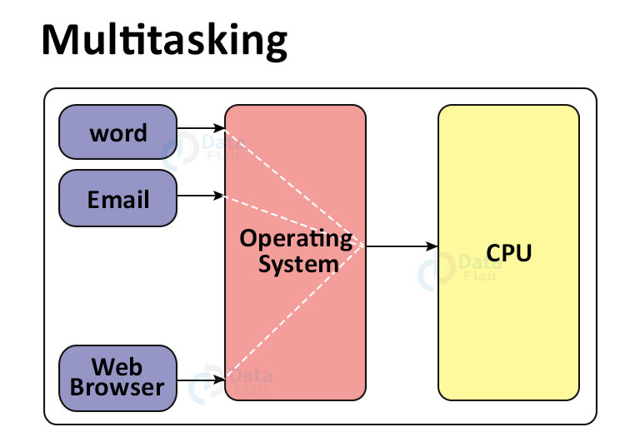
Types of Operating Systems(CO1)

Slide 47
Types of Operating Systems(CO1)
Advantages of Multi-Tasking
Saves time
For a user, multiple files can be worked upon simultaneously at the same time.
Disadvantages of Multitasking
For a new user, it might be a little confusing
High chances of the computer program being affected
Speed might be affected as well

Slide 48
Types of Operating Systems(CO1)
4. Distributed OS
In a distributed OS, various computers are connected through a single communication channel. These independent computers have their memory unit and CPU and are known as loosely coupled systems. The system processes can be of different sizes and can perform different functions. The major benefit of such a type of operating system is that a user can access files that are not present on his system but another connected system. In addition, remote access is available to the systems connected to this network.

Slide 49
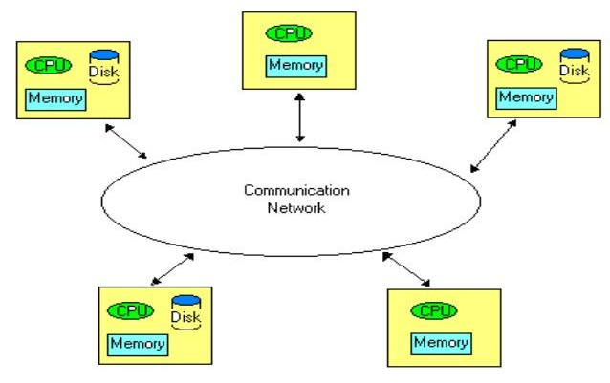
Types of Operating Systems(CO1)
4. Distributed OS

Slide 50
Types of Operating Systems(CO1)
Advantages of Distributed OS
Failure of one system will not affect the other systems because all the computers are independent of each other.
The load on the host system is reduced.
As the workload and resources are shared therefore the calculations are performed at a higher speed.

Slide 51
Types of Operating Systems(CO1)
Disadvantages of Distributed OS
The setup cost is high.
Software used for such systems is highly complex.
Failure of the main network will lead to the failure of the whole system.
Examples of Distributed OS: LOCUS, etc.

Slide 52
Types of Operating Systems(CO1)
4. Network Operating System:-
Network operating systems are the systems that run on a server and manage all the networking functions. They allow sharing of various files, applications, printers, security, and other networking functions over a small network of computers like LAN or any other private network. In the network OS, all the users are aware of the configurations of every other user within the network, which is why network operating systems are also known as tightly coupled systems.

Slide 53
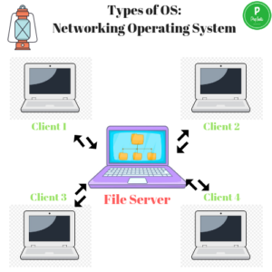
Types of Operating Systems(CO1)
4. Network Operating System:-

Slide 54
Types of Operating Systems(CO1)
Advantages of Network OS
New technologies and hardware can easily upgrade the systems.
Security of the system is managed over servers.
Servers can be accessed remotely from different locations and systems.
The centralized servers are stable.

Slide 55
Types of Operating Systems(CO1)
Disadvantages of Network OS
Server costs are high.
Regular updates and maintenance are required.
Users are dependent on the central location for the maximum number of operations.
Examples of Network OS: Microsoft Windows server 2008, LINUX, etc.

Slide 56
Types of Operating Systems(CO1)
5. Real-Time OS (RTOS)
In these systems, the time interval for processing and responding to inputs is very small. Therefore, due to this quality, these are used in real-time situations. Eg: Industrial control systems, Scientific experiments, Air traffic control systems, etc.They have two categories as follows:
a) Hard Real-Time Systems
In this, the time constraint is very short and strict. Even seconds of delay is not acceptable.
b) Soft Real-Time Systems
In this, the time constraint is not so short and strict.

Slide 57
Types of Operating Systems(CO1)
Clustered Operating System
clustered systems are made by two or more individual systems but they are connected with each other. They have independent computer system along with shared storage medium and all systems perform all tasks together. All nodes of clusters implement two different techniques for making communication with each other like as message passing Interface (MPI) and Parallel virtual machine (PVM).

Slide 58
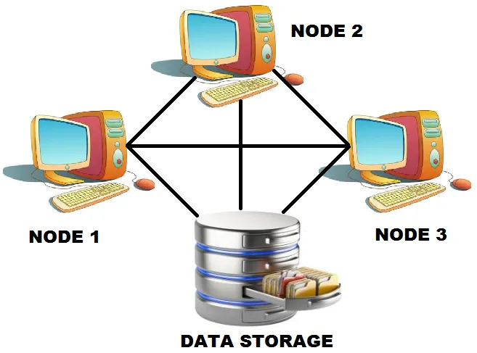
Types of Operating Systems(CO1)

Slide 59
Types of Operating Systems(CO1)
Types of Clustered System
There are primarily three types of cluster system. Below explain each one –
1. Symmetric Cluster: In this type of clustering, all the nodes run applications and monitor other nodes at the same time.
2. Asymmetric Cluster: In this type of clustering, one of the nodes is in a hot standby mode, while rest all nodes run different applications. The node which is in hot standby mode continuously monitors the entire cluster and act as a replacement if any of the nodes fails.
3 Parallel Cluster: These clusters enable multiple users to access the same data on the shared storage. It is accomplished by using special software versions and applications.

Slide 60
Types of Operating Systems(CO1)
Advantages of Clustered System
The benefits of clustered system are:
High Performance
Increased fault tolerance
High scalability
Disadvantages of Clustered System
The limitations of clustered system are:
Expensive to implement
System establishment, monitoring, and maintenance is complex

Slide 61
System Calls(CO1)
A system call is a mechanism that provides the interface between a process and the operating system. It is a programmatic method in which a computer program requests a service from the kernel of the OS.
System call offers the services of the operating system to the user programs via API (Application Programming Interface). System calls are the only entry points for the kernel system.

Slide 62
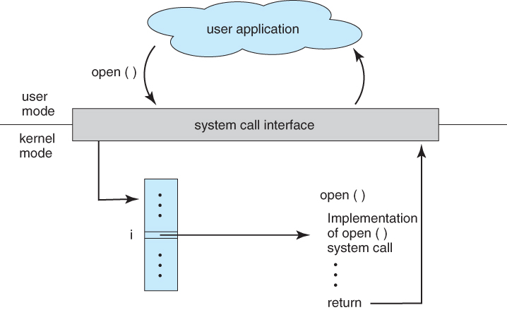
System Calls(CO1)

Slide 63
System Calls(CO1)
Example of System Call
For example if we need to write a program code to read data from one file, copy that data into another file. The first information that the program requires is the name of the two files, the input and output files.
In an interactive system, this type of program execution requires some system calls by OS.
First call is to write a prompting message on the screen
Second, to read from the keyboard, the characters which define the two files.

Slide 64
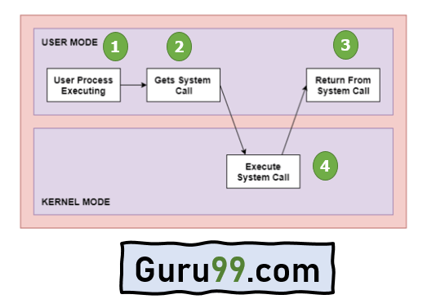
System Calls(CO1)
Working:-
Step 1) The processes executed in the user mode till the time a system call interrupts it.
Step 2) After that, the system call is executed in the kernel-mode on a priority basis.
Step 3) Once system call execution is over, control returns to the user mode.,
Step 4) The execution of user processes resumed in Kernel mode.

Slide 65
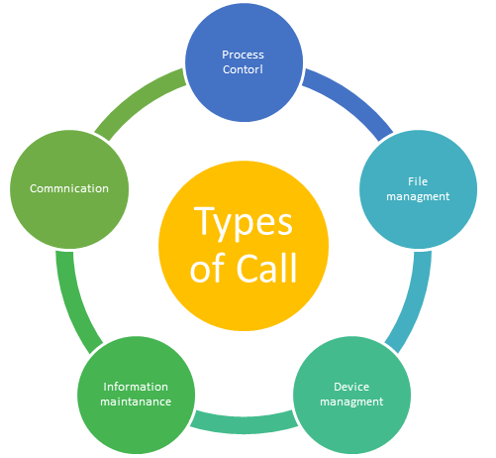
System Calls(CO1)
Types of System calls
Here are the five types of System Calls in OS:
Process Control
File Management
Device Management
Information Maintenance
Communications

Slide 66
Process control (CO1)
Process Control
This system calls perform the task of process creation, process termination, etc.
Functions:
End and Abort
Load and Execute
Create Process and Terminate Process
Wait and Signal Event
Allocate and free memory

Slide 67
File management (CO1)
File Management
File management system calls handle file manipulation jobs like creating a file, reading, and writing, etc.
Functions:
Create a file
Delete file
Open and close file
Read, write, and reposition
Get and set file attributes

Slide 68
Device management (CO1)
Device Management
Device management does the job of device manipulation like reading from device buffers, writing into device buffers, etc.
Functions:
Request and release device
Read, Write and Reposition
Logically attach/ detach devices
Get and Set device attributes

Slide 69
Information Maintenance(CO1)
Information Maintenance
It handles information and its transfer between the OS and the user program.
Functions:
Get or set time and date
Get process and device attributes
Get and set system data
Get process , file or device attribute
Set process , file or device attribute

Slide 70
Communication(CO1)
Communication:
These types of system calls are specially used for inter-process communications.
Functions:
Create, delete communications connections
Send, receive message
Help OS to transfer status information
Attach or detach remote devices

Slide 71
System Programs(CO1)
System programs provide a convenient environment for program development and execution. System programs provide OS functionality through separate applications, which are not part of the kernel or command interpreters. They are also known as system utilities or system applications.
Some of them provide user interface to system calls and other are considerably more complex.

Slide 72
System Programs(CO1)
They can be divided into these categories
i) File management
ii) Status information
iii) File manipulation
iv) Programming language support
v) Program loading and execution
vi) Communications

Slide 73
System Programs(CO1)
File Management
These programs create, delete, copy, rename, print, dump, list and generally manipulate files and directories
Status information
Information like date, time amount of available memory, or disk space is asked by some users. Others providing detailed performance, logging, and debugging information which is more complex. All this information is formatted and displayed on output devices or printed. Terminal or other output devices or files or a window of GUI is used for showing the output of programs.

Slide 74
System Programs(CO1)
File Modification
For modifying the contents of files we use this. For Files stored on disks or other storage devices, we used different types of editors. For searching contents of files or perform transformations of files we use special commands.
Programming-Language support
For common programming languages, we use Compilers, Assemblers, Debuggers, and interpreters which are already provided to users. It provides all support to users. We can run any programming language. All languages of importance are already provided.

Slide 75
System Programs(CO1)
Program loading and Execution
When the program is ready after Assembling and compilation, it must be loaded into memory for execution. A loader is part of an operating system that is responsible for loading programs and libraries. It is one of the essential stages for starting a program. Loaders, relocatable loaders, linkage editors, and Overlay loaders are provided by the system.
Communication
Virtual connections among processes, users, and computer systems are provided by programs. Users can send messages to another user on their screen, User can send e-mail, browsing on web pages, remote login, the transformation of files from one user to another.

Slide 76
System Boot(CO1)
Booting is the process which is initiated once the computer system starts and executes small set of instructions present in the ROM which will setup system hardware by testing them and load the operating system so that computer system can carry out further tasks.
Type of Booting:
There are two types of Booting available:
Cold Booting/ Hard Booting: Cold booting is the process when our computer system moves from shut down state to the start by pressing the power button. The system reads the BIOS from ROM and will eventually load the Operating System.
Warm Booting/ Soft Booting: Warm booting is the process in which the computer gets restart due to reasons like setting the configuration for newly installed software or hardware. Warm booting is called as rebooting.

Slide 77
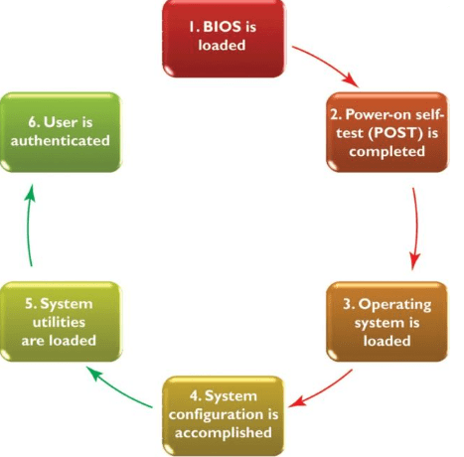
System Boot(CO1)
Steps In the Booting Process

Slide 78
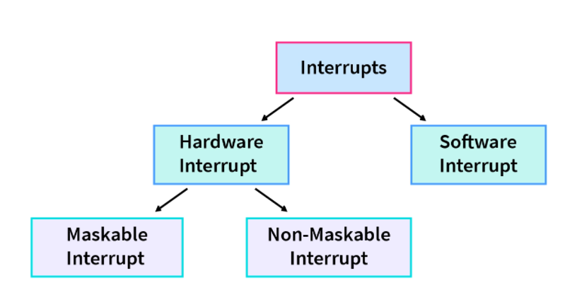
Interrupt Handling(CO1)
Interrupts are the event that can be caused by hardware or software that need immediate attention and handle by the Interrupt Service Routine (ISR) which contains the information for dealing with the interrupt.

Slide 79
Interrupt Handling(CO1)
Hardware Interrupts:
When an external device wants the attention of the operating system to service a certain request, they raise an interrupt which is called hardware interrupts. All the external devices are connected to a single Interrupt Request Line and the Interrupt Request Line is used for the interrupts.
The hardware interrupts are further categorized into two types:
Maskable Interrupts: Hardware interrupts that can be ignored or disabled are called maskable interrupts.
Non-Maskable interrupts: Hardware interrupts that can’t be ignored or disabled are called non-maskable interrupts.

Slide 80
Interrupt Handling(CO1)
Software Interrupts:
Software interrupts generally take place when there are exceptions in the process or by using special instructions that cause the interrupts. While having the system calls in our system, we generally have the software interrupt. Division by zero throws an exception which caused the software interrupt, whereas while we use fork() system call, fork() also invokes a software interrupt.

Slide 81
Interrupt Handling(CO1)
Steps are involved while handling the interrupts:
The First step involved in handling the interrupt is to check the priority of the interrupt.
If the priority is low compared to the current process under execution, then interrupt is saved in the memory.
If the priority is high compared to the current process under execution, CPU saves the context of the current process.
CPU loads the new process which invoked the interrupt and executes that.
On completion of the requested service, CPU loads the process which was under execution prior to the interrupt and resumes the execution from where the execution was interrupted.

Slide 82
Operating System Services(CO1)
An Operating System supplies different kinds of services to both the users and to the programs as well. It also provides application programs (that run within an Operating system) an environment to execute it freely. It provides users the services run various programs in a convenient manner.
User Interface
Program Execution
File system manipulation
Input / Output Operations
Communication
Resource Allocation
Error Detection
Accounting
Security and protection

Slide 83
Operating System Services(CO1)
1. User Interface
An interface is required to communicate with the user. Then it can either be a Command Line Interface or a Graphical User Interface. There is also a third kind that is Batch Based Interface which is usually overlooked. It uses commands to manage the commands entered into files and then these files get executed.
As for the first two, Command Line Interface commonly uses text commands input by the users to interact with the system. These commands can also be given using a terminal emulator, or remote shell client.
A Graphical User Interface (GUI) allows users to interact with the computer system or any other computer-controlled device.

Slide 84

Operating System Services(CO1)
2. Program Execution
The OS loads a program into memory and then executes that program. It also makes sure that once started that program can end its execution, either normally or forcefully. The major steps during program management are:
Loading a program into memory.
Executing the program.
Making sure the program completes its execution.
Providing a mechanism for: 1. process synchronization. 2. process communication. 3. deadlock handling.

Slide 85
Operating System Services(CO1)
3. File System Manipulation
A program is read and then written in the form of directories and files. These files can be stored on the storage disk for the long term. The OS allows the users to create and delete files, duplicate these files, and search files and their information or properties.
It also does permission management for these files i.e., allowing or denying access to these files or directories based on the file ownership.

Slide 86
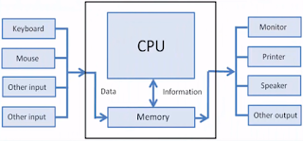
Operating System Services(CO1)
4. I/O Operations
I/O operations are required during the execution of a program. To maintain efficiency and protection of the program, users cannot directly govern the I/O devices instead the OS allows to read or write operations with any file using the I/O devices and also allows access to any required I/O device when required.

Slide 87
Operating System Services(CO1)
5. Communication systems
Processes need to swap information among themselves. These processes can be from the same computer system or different computer systems as long as they are connected through communication lines in a network.
This can be done with the help of OS support using shared memory or message passing.

Slide 88
Operating System Services(CO1)
6. Resource Allocation
When multiple users or multiple jobs run on a system concurrently, the resources need to be allocated equally to all of them.
CPU scheduling is used to allocate resources fairly and for the better utilization of the CPU. These resources may include CPU cycles, main memory storage, file storage, and I/O devices.

Slide 89
Operating System Services(CO1)
7. Error Detection
Errors may occur in any of the resources like CPU, I/O devices, or memory hardware. The OS keeps a lookout for such errors, corrects errors when they occur, and makes sure that the system works uninterruptedly.
8. Accounting
This keeps a check of which resource is being used by a user and for how long it is being used. This is usually done for statistical purposes.

Slide 90
Operating System Services(CO1)
9. Protection and Security
This is to ensure the safety of the system. Thus, user authentication is required to access a system. It is also necessary to protect a process from another when multiple processes are running on a system at the same time.
The OS controls the access to the resources, protects the I/O devices from invalid access, and provides authentication through passwords.

Slide 91
Operating System Services(CO1)
10.Resource Manager
The OS manages resources such as processor, memory, I/O devices etc efficiently. It allocates resources to processes and administers running programs to ensure user satisfaction.
It also decides the time at which a program should run, the amount of memory allocated for execution, where to save a file, and much more.

Slide 92
Daily Quiz
While CPU is executing a program, an interrupt exists then it a) follows the next instruction in the program b) jumps to instruction in other registers c) breaks the normal sequence of execution of instructions d) stops executing the program
Ans c
An interrupt breaks the execution of instructions and diverts its execution to a) Interrupt service routine b) Counter word register c) Execution unit d) control unit
Ans a
While executing the main program, if two or more interrupts occur, then the sequence of appearance of interrupts is called a) multi-interrupt b) nested interrupt c) interrupt within interrupt d) nested interrupt and interrupt within interrupt
Ans d

Slide 93
Operating System Structure (CO1)
General-purpose OS is very large program
● Various ways to structure ones
● Simple structure – MS-DOS
● More complex -- UNIX
● Layered structure
● Microkernel

Slide 94
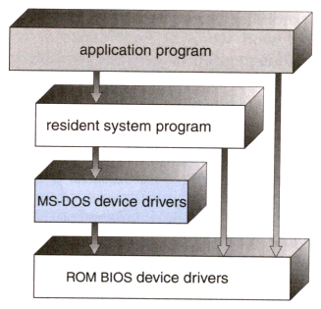
Simple Structure (CO1)
Operating systems such as MS-DOS and the original UNIX did not have well-defined structures.
There was no CPU Execution Mode (user and kernel), and so errors in applications could cause the whole system to crash.

Slide 95
Simple Structure (CO1)
Advantages of Simple structure:
It delivers better application performance because of the few interfaces between the application program and the hardware.
Easy for kernel developers to develop such an operating system.
Disadvantages of Simple structure:
The structure is very complicated as no clear boundaries exists between modules.
It does not enforce data hiding in the operating system.

Slide 96
Operating System Structure – Layered Approach(CO1)
Layered structure:
In this structure the OS is broken into number of layers (levels). The bottom layer (layer 0) is the hardware and the topmost layer (layer N) is the user interface.
These layers are so designed that each layer uses the functions of the lower level layers only.
This simplifies the debugging process as if lower level layers are debugged and an error occurs during debugging then the error must be on that layer only as the lower level layers have already been debugged.

Slide 97
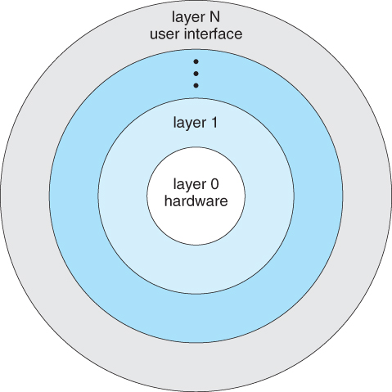
An Operating System Layer(CO1)

Slide 98
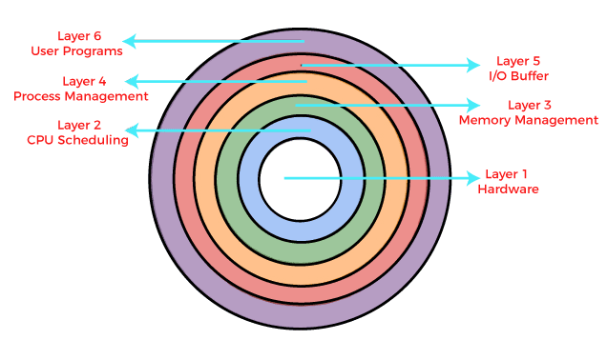
Layered Structure of the OS(CO1)
A layered design was first used in THE operating system. Its six layers are as follows:

Slide 99
Layered Structure of the OS(CO1)
Advantages of Layered structure:
Layering makes it easier to enhance the operating system as implementation of a layer can be changed easily without affecting the other layers.
It is very easy to perform debugging and system verification.
Disadvantages of Layered structure:
In this structure the application performance is degraded as compared to simple structure.
It requires careful planning for designing the layers as higher layers use the functionalities of only the lower layers.

Slide 100
Monolithic kernel(CO1)
Monolithic System Architecture
The entire operating system works in the kernel space in the monolithic system.
This increases the size of the kernel as well as the operating system.
The kernel provides various services such as memory management, file management, process scheduling etc. using function calls.
This makes the execution of the operating system quite fast as the services are implemented under the same address space.

Slide 101
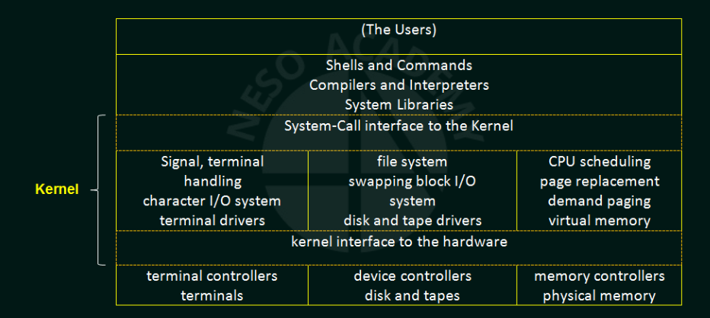
Monolithic kernel(CO1)

Slide 102
Monolithic kernel(CO1)
Advantages of Monolithic Kernel
The execution of the monolithic kernel is quite fast as the services such as memory management, file management, process scheduling etc.are implemented under the same address space.
A process runs completely in a single address space in the monolithic kernel.
The monolithic kernel is a static single binary file.

Slide 103
Monolithic kernel(CO1)
Disadvantages of Monolithic Kernel
If any service fails in the monolithic kernel, it leads to the failure of the entire system.
To add any new service, the entire operating system needs to be modified by the user.

Slide 104
Micro kernel(CO1)
This structures the operating system by removing all nonessential portions of the kernel and implementing them as system and user level programs.
Generally they provide minimal process and memory management, and a communications facility.
Communication between components of the OS is provided by message passing.
The benefits of the microkernel are as follows:
Extending the operating system becomes much easier.
Any changes to the kernel tend to be fewer, since the kernel is smaller.
The microkernel also provides more security and reliability.

Slide 105
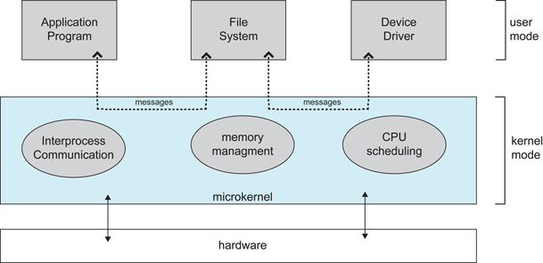
Micro kernel(CO1)

Slide 106
Micro kernel(CO1)
Advantages of Micro-kernel structure:
It makes the operating system portable to various platforms.
As microkernels are small so these can be tested effectively.
Disadvantages of Micro-kernel structure:
Increased level of inter module communication degrades system performance.

Slide 107
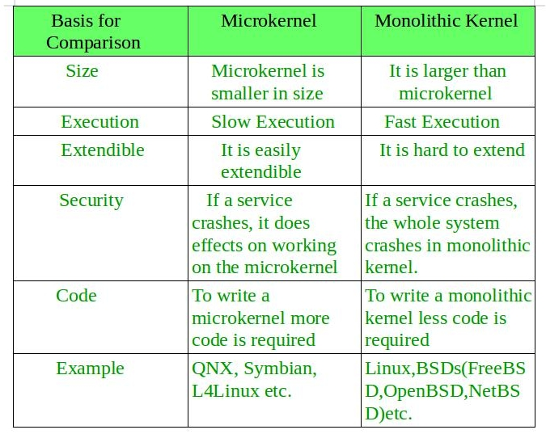
Comparison between Monolithic and Microkernel(CO1)

Slide 108
Hybrid System(CO1)
Hybrid System
Combination of more than one structure is known as Hybrid Structure
Hybrid system is a type of system which is used for increasing the performance, security and other user services and it is very efficient in the operating system.

Slide 109
Hybrid System(CO1)
Types of Hybrid Systems
Mac OS
The mac OS generally uses a hybrid structure and it is a layered system, the Mac OS consists of a microkernel and it is also used in memory management and also supports for networking and file systems.
The Mac OS is also used for different applications so that a number of software’s can work in the OS and the apple company mainly used the Mac OS in the computer or other devices.

Slide 110
Hybrid System(CO1)
Types of Hybrid Systems
iOS
iOS is one type of operating system designed by Apple to run its smartphones, iphones as well as tablets. iOS is structured on the Mac OS and in Iphone , ipad, ipod the company uses the iOS operating system.
iOS is developing applications that run on iOS devices and iOS is a better method for communication on the mobile.

Slide 111
Hybrid System(CO1)
Android OS
The android operating system was developed for android smartphones and tablet computers and the android OS is used for a variety of mobile platforms and for the open-source OS.
It is a user-friendly operating system. Android OS is also similar to IOS and it is used for layered structure and different layers are involved in it to form the android operating system.

Slide 112
Hybrid System(CO1)
Microsoft Windows NT kernel −
The Microsoft Windows NT kernel is also called as a hybrid system, the NT stands for new technology.
It has advanced networking capabilities and hardware support, it was introduced in the year 1993. Later Windows NT was replaced by windows 2000 but still, it had the Windows NT Kernel.

Slide 113
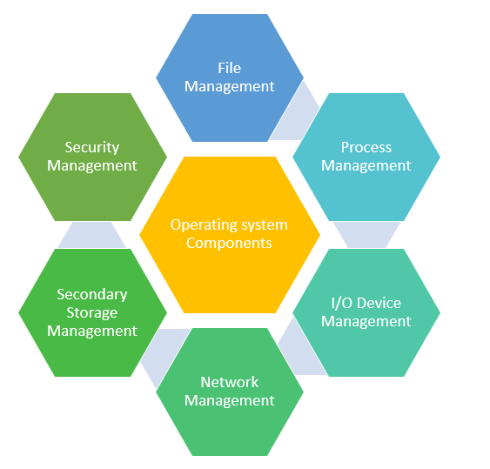
System Components(CO1)
Process Management
Secondary-Storage Management
I/O System Management
File Management
Network management
Security Management

Slide 114
Process Management(CO1)
A process is a program in execution. A process needs certain resources, including CPU time, memory, files, and I/O devices, to accomplish its task.
The operating system is responsible for the following activities in connection with process management.
Process creation and deletion.
process suspension and resumption.
Provision of mechanisms for:
process synchronization
process communication

Slide 115
Secondary-Storage(CO1)
Since main memory (primary storage) is volatile and too small to accommodate all data and programs permanently, the computer system must provide secondary storage to back up main memory.
Most modern computer systems use disks as the principle on-line storage medium, for both programs and data.
The operating system is responsible for the following activities in connection with disk management:
Free space management
Storage allocation
Disk scheduling

Slide 116
I/O System Management(CO1)
The I/O system consists of:
A buffer-caching system
A general device-driver interface
Drivers for specific hardware devices

Slide 117
File Management(CO1)
A file is a collection of related information defined by its creator. Commonly, files represent programs (both source and object forms) and data.
The operating system is responsible for the following activities in connections with file management:
File creation and deletion.
Directory creation and deletion.
Support of primitives for manipulating files and directories.
Mapping files onto secondary storage.
File backup on stable (nonvolatile) storage media.

Slide 118
Network Management(CO1)
Network management is the process of administering and managing computer networks. It includes performance management, fault analysis, provisioning of networks, and maintaining the quality of service.
Functions of Network management:
Distributed systems help you to various computing resources in size and function. They may involve microprocessors, minicomputers, and many general-purpose computer systems.
A distributed system also offers the user access to the various resources the network shares.
It helps to access shared resources that help computation to speed-up or offers data availability and reliability.

Slide 119
Security Management(CO1)
Security Management
The various processes in an operating system need to be secured from each other’s activities. For that purpose, various mechanisms can be used to ensure that those processes which want to operate files, memory CPU, and other hardware resources should have proper authorization from the operating system.
For example, Memory addressing hardware helps you to confirm that a process can be executed within its own address space. The time ensures that no process has control of the CPU without renouncing it.

Slide 120
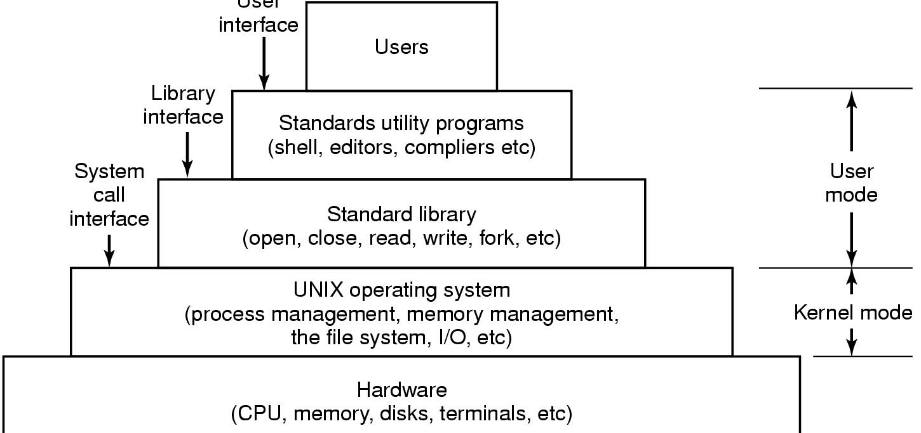
Case Studies: Windows, Unix and Linux
User Interface

Slide 121
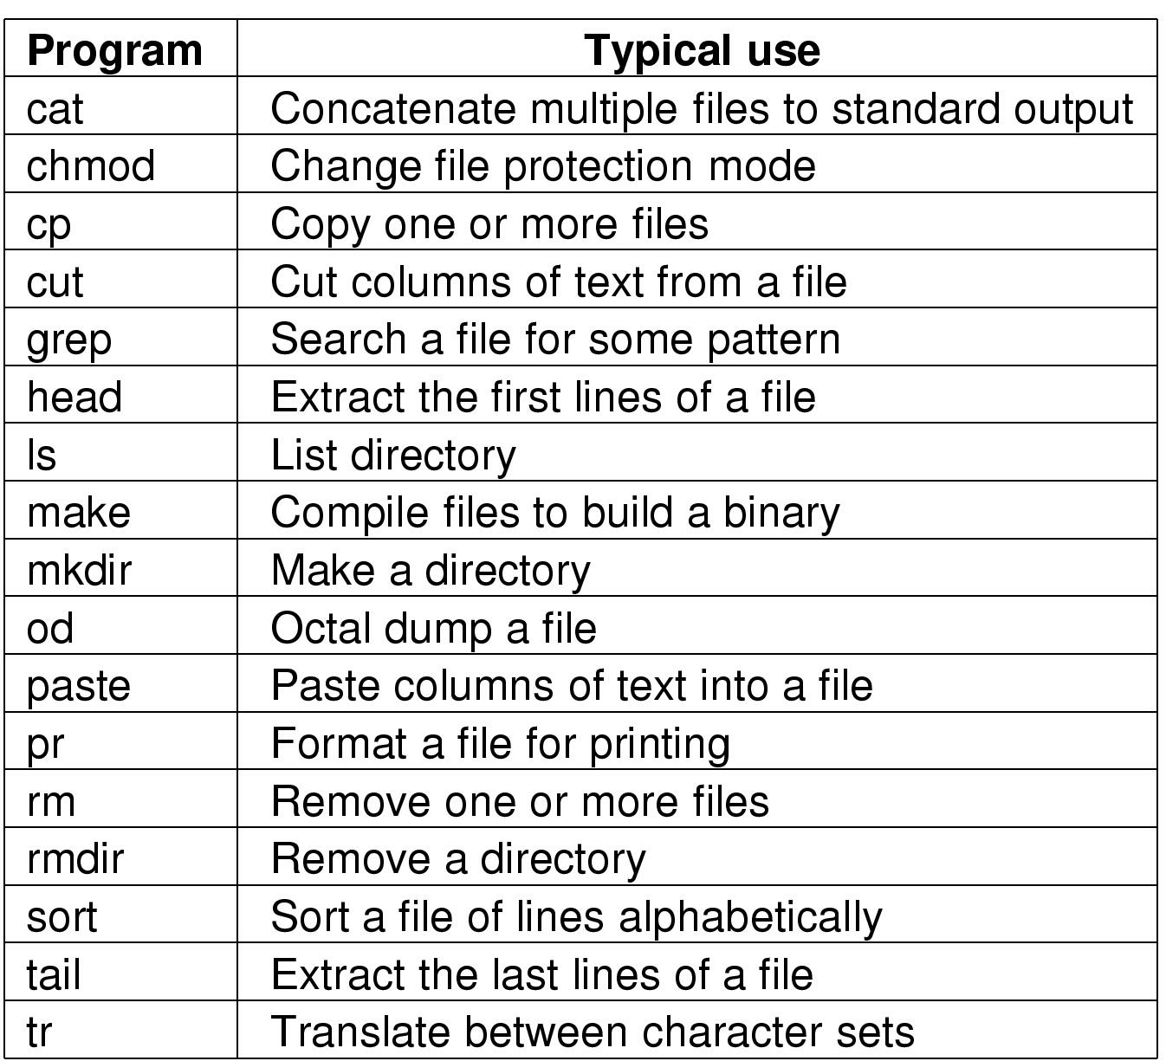
Case Studies: Windows, Unix and Linux
UNIX Utility Programs

Slide 122
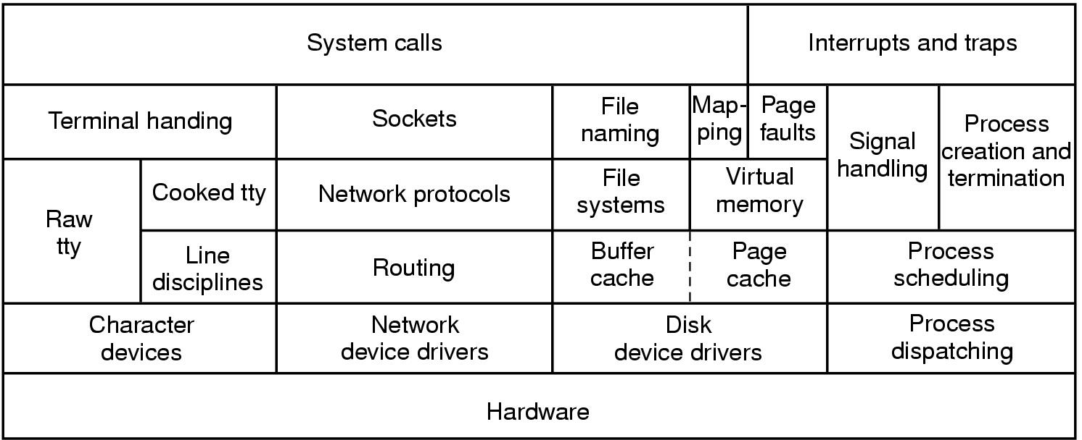
Case Studies: Windows, Unix and Linux
UNIX Kernel

Slide 123
Faculty Video Links, Youtube & NPTEL Video Links and Online Courses Details
Youtube/other Video Links
https://www.youtube.com/playlist?list=PLBlnK6fEyqRiVhbXDGLXDk_OQAeuVcp2O
https://nptel.ac.in/courses/106108101

Slide 124
MCQ s
MCQ Link:-
https://www.mcqslearn.com/cs/operating-systems/mcq/introduction-to-operating-systems-multiple-choice-questions-answers.php
https://www.mcqslearn.com/cs/operating-systems/mcq/introduction-to-operating-systems-multiple-choice-questions-answers.php?page=2
https://www.mcqslearn.com/cs/operating-systems/mcq/introduction-to-operating-systems-multiple-choice-questions-answers.php?page=3
https://www.mcqslearn.com/cs/operating-systems/mcq/introduction-to-operating-systems-multiple-choice-questions-answers.php?page=4
https://www.mcqslearn.com/cs/operating-systems/mcq/introduction-to-operating-systems-multiple-choice-questions-answers.php?page=5

Slide 125
Old Question Papers
Last 12 Years University paper Link:-
https://drive.google.com/drive/folders/1UPXvZ7NY09OunSLrEkTFWpw_M3xLzjhs?usp=sharing

Slide 126
Expected Questions for University Exam
Expected Unit Wise Question link:
https://drive.google.com/drive/folders/1-4f69kIkRvcOYgr_P_VzFgXtRzsS4ilV?usp=sharing

Slide 127
Daily Quiz
1.When a computer is first turned on or restarted, a special type of absolute loader called ____ is executed A. Compile and Go loader B. Boot loader C. Bootstrap loader D. Relating loader
2.To access the services of operating system, the interface is provided by the ___________
System calls
API
Library
Assembly instructions

Slide 128
Weekly Assignment
List the advantages of multiprocessor system?
List the services provided by an Operating System.
Describe differences between symmetric and asymmetric multiprocessing.
Mention the objectives and functions of OS

Slide 129
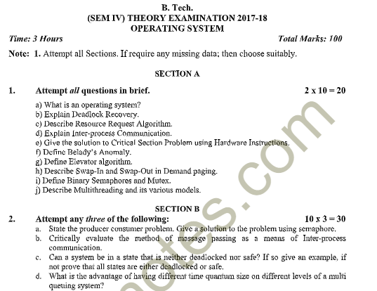
Old Question Papers

Slide 130
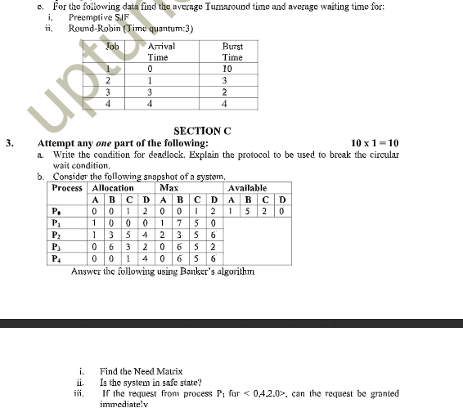
Old Question Papers

Slide 131
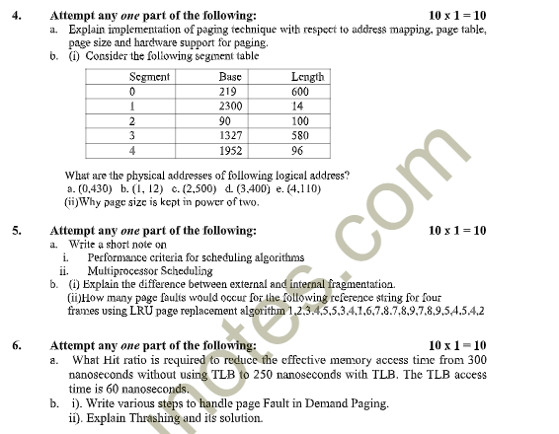
Old Question Papers

Slide 132
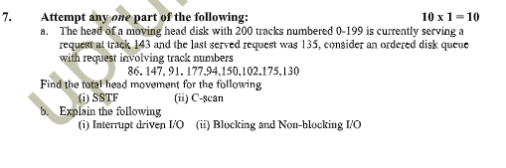
Old Question Papers

Slide 133
Glossary Questions
Choose the correct
1.The multi-user Operating System is based on the concept of ____
2. Operating system_________
3. ____ systems have more than one CPU in close communication with the others.
4. On systems where there are multiple operating system, the decision to load a particular one is done by _____________
(Multiprocessor,Provides a layer and user friendly interface, boot loader,Time-sharing, )

Slide 134
Recap of Unit
Summary of UNIT 1
In this module,
we have studied the following:
Overview and Concepts of Operating system
What is Operating system
Types of operating system
Layered architecture of Operating system
System components
OS services
System calls and types of system calls
Kernel
Monolithic Kernel
Micro Kernel
Reentrant kernel
Operating System Concets

Slide 135
References
Books :
Silberschatz, Galvin and Gagne, “Operating Systems Concepts”, Wiley
SibsankarHalder and Alex A Aravind, “Operating Systems”, Pearson Education
Harvey M Dietel, “ An Introduction to Operating System”, Pearson Education
D M Dhamdhere, “Operating Systems : A Concept basedApproach”, McGraw Hill.
Charles Crowley, “Operating Systems: A Design-Oriented Approach”, Tata McGraw Hill Education”.
Stuart E. Madnick & John J. Donovan, “ Operating Systems”, Tata McGraw
Operating System Concets

Slide 136
Thank You

